Slide 1

Multimedia Data Management
Lecture 7 – Nested Queries / Join / Views
Fall 2022

Slide 2
A subquery is a SELECT-FROM-WHERE expression that is nested within another query.
Notes:
We already learned to use subqueries inside WHERE predicates

Slide 3
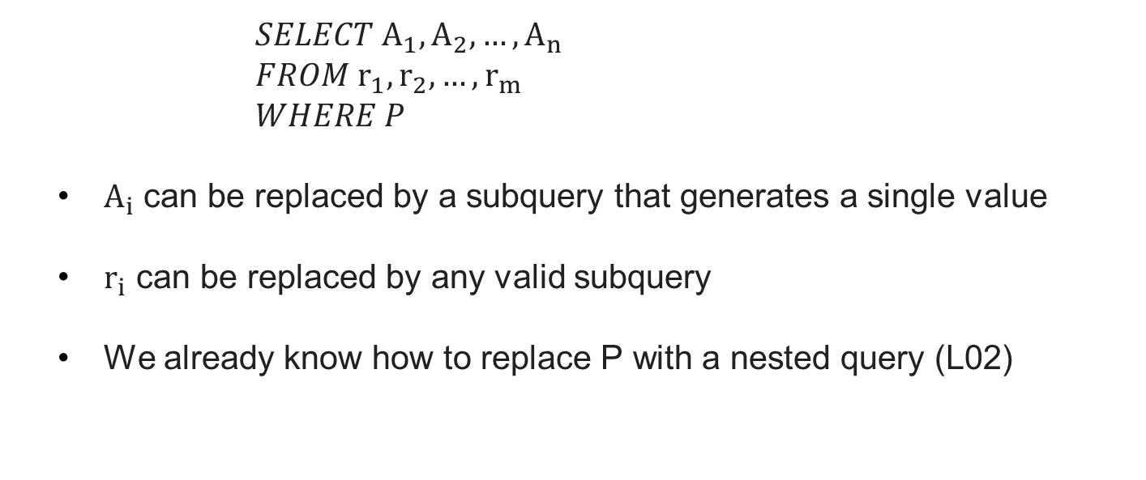
Nested Subqueries
$SELECT A_{1},A_{2},…, A_{n}$
$FROM r_{1},r_{2},…, r_{m}$
$WHERE P$
$A_{i}$ can be replaced by a subquery that generates a single value
$r_{i}$ can be replaced by any valid subquery
We already know how to replace P with a nested query (L02)

Slide 4
Nested FROM Clause
SQL allows a subquery expression to be used in the FROM clause
Find the departments where the average salary is greater than $42,000
SELECT dept_name
FROM (
SELECT dept_name, AVG(salary) AS avg_salary
FROM instructor
GROUP BY dept_name)
WHERE avg_salary > 42000;
Notes:
But we know a better query to execute

Slide 5
WITH Clause
The WITH clause provides a way of defining a temporary relation the scope of which is only bound to a query.
Find the departments with maximum budget
WITH max_budget (val) AS (
SELECT MAX(budget)
FROM department)
SELECT dept_name
FROM department, max_budget
WHERE budget = max_budget.val;

Slide 6
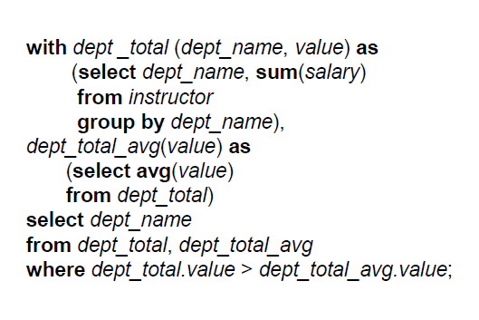
Complex WITH Clause
WITH clause enables us to use aggregate functions on the result of another aggregate function more easily.
Find the departments where the total salary is above average.

Slide 7
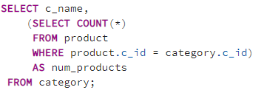
Nested SELECT Clause
Subqueries in SELECT clause most return a scalar (single) value for each row returned by the outer query
Find category names along with the number of products for each category
Notes:
assignment 1

Slide 8
JOIN Example
Relation course
Relation prereq

Slide 9
JOIN Example
course natural join prereq
Notes:
prereq information is missing for CS-315 and
course information is missing for CS-437
We call it inner join too
The default join type, when the join clause is used without the outer prefix is the inner join

Slide 10
(Full) Outer JOIN
An extension of the join operation that avoids loss of information
Computes the join and then adds tuples from one relation that does not match tuples in the other relation to the result of the join using null values

Slide 11
Left (Outer) JOIN
course left (outer) join prereq

Slide 12
Right (Outer) JOIN
course right (outer) join prereq

Slide 13
(Full) Outer JOIN
course (full) outer join prereq

Slide 14
JOIN Syntax
JOIN/ON syntax is more recent and more explicit that WHERE clause
We should handle duplicate columns ourselves
We should avoid ambiguous column names by using table names

Slide 15
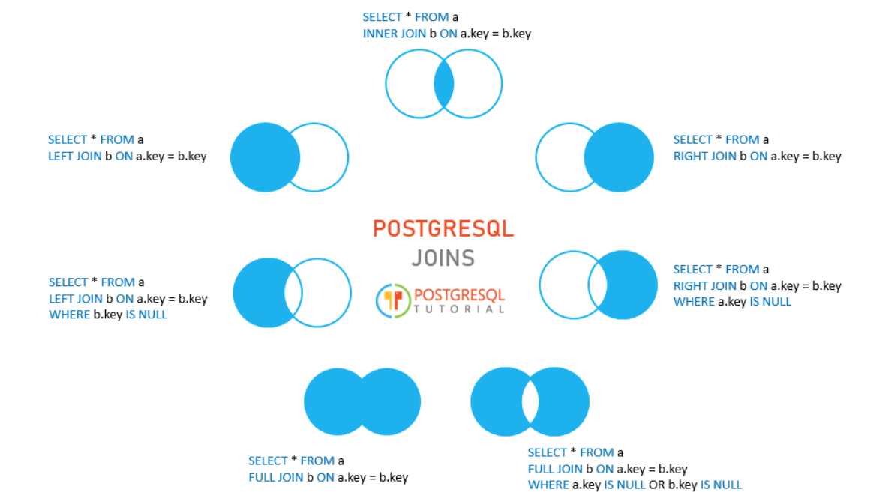
JOIN Syntax
These are PostgreSQL JOIN options:
Notes:
JOIN (INNER JOIN)
LEFT (OUTER) JOIN
RIGHT (OUTER) JOIN
FULL (OUTER) JOIN
CROSS JOIN (be careful !)

Slide 16
SQL VIEW
In some cases, it is not desirable for all users to see the entire logical model (all the actual relations in the database)
Consider a person who needs to know an instructor’s name and department, but not the salary. This person should see a relation described, in SQL, by select ID, name, dept_name from instructor
A VIEW provides a mechanism to hide certain data from the view of certain users.
Any relation that is not of the conceptual model but is made visible to a user as a “virtual relation” is called a VIEW.
Notes:
The result of a select query is a view anyway. But we are also able to store frequent queries as views

Slide 17
VIEW Example
A view of instructors without their salary
CREATE VIEW faculty AS
SELECT id, name, dept_name FROM instructor
Find all instructors in the Biology department
SELECT name FROM faculty WHERE dept_name = ‘Biology’

Slide 18
Nested VIEW
CREATE VIEW physics_fall_2009 AS SELECT course.course_id, sec_id, building, room_number FROM course, section WHERE course.course_id = section.course_id AND course.dept_name = ’Physics’ AND section.semester = ’Fall’ AND section.year = ’2009’;
CREATE VIEW physics_fall_2009_watson AS SELECT course_id, room_number FROM physics_fall_2009 WHERE building= ’Watson’;

Slide 19
Update VIEW
Add a new tuple to faculty view which we defined earlier
INSERT INTO faculty VALUES (’30765’, ’Green’, ’Music’);
This insertion must be represented by the insertion of the tuple
(’30765’, ’Green’, ’Music’, null)
into the instructor relation

Slide 20
VIEW Update Translation
Most SQL implementations allow updates only on simple views
The FROM clause has only one database relation
The SELECT clause contains only attribute names of the relation, and does not have any expressions, aggregates, or DISTINCT specification
Any attribute not listed in the SELECT clause can be set to null
The query does not have a GROUP BY or HAVING clause

Slide 21
VIEW Update Translation
CREATE VIEW history_instructors AS SELECT * FROM instructor WHERE dept_name = ’History’;
What happens if we INSERT (’25566’, ’Brown’, ’Biology’, 100000) into history_instructors?
Notes:
It will be inserted into the actual table but filtered out from the view why?

Slide 22
Materialized VIEW
Materializing a view: create a physical table containing all the tuples in the result of the query defining the view
If relations used in the query are updated, the materialized view result becomes out of date
Need to maintain the view, by updating the view whenever the underlying relations are updated.

Slide 23
Transactions
Unit of work / Atomic transaction
either fully executed or rolled back as if it never occurred
Isolation from concurrent transactions
Transactions begin implicitly
Ended by commit work or rollback work

Slide 24
Integrity Constraints
Integrity constraints guard against accidental damage to the database, by ensuring that authorized changes to the database do not result in a loss of data consistency.
A checking account must have a balance greater than $10.00
A salary of a bank employee must be at least $18.00 an hour
A customer must have a (non-null) phone number

Slide 25
Integrity Constraints
We already know some integrity constraints on a single relation:
NOT NULL
PRIMARY KEY
UNIQUE
CHECK (P), where P is a predicate

Slide 26
Integrity Constraints
We already know some integrity constraints on a single relation:
NOT NULL
PRIMARY KEY
UNIQUE
CHECK (P), where P is a predicate

Slide 27
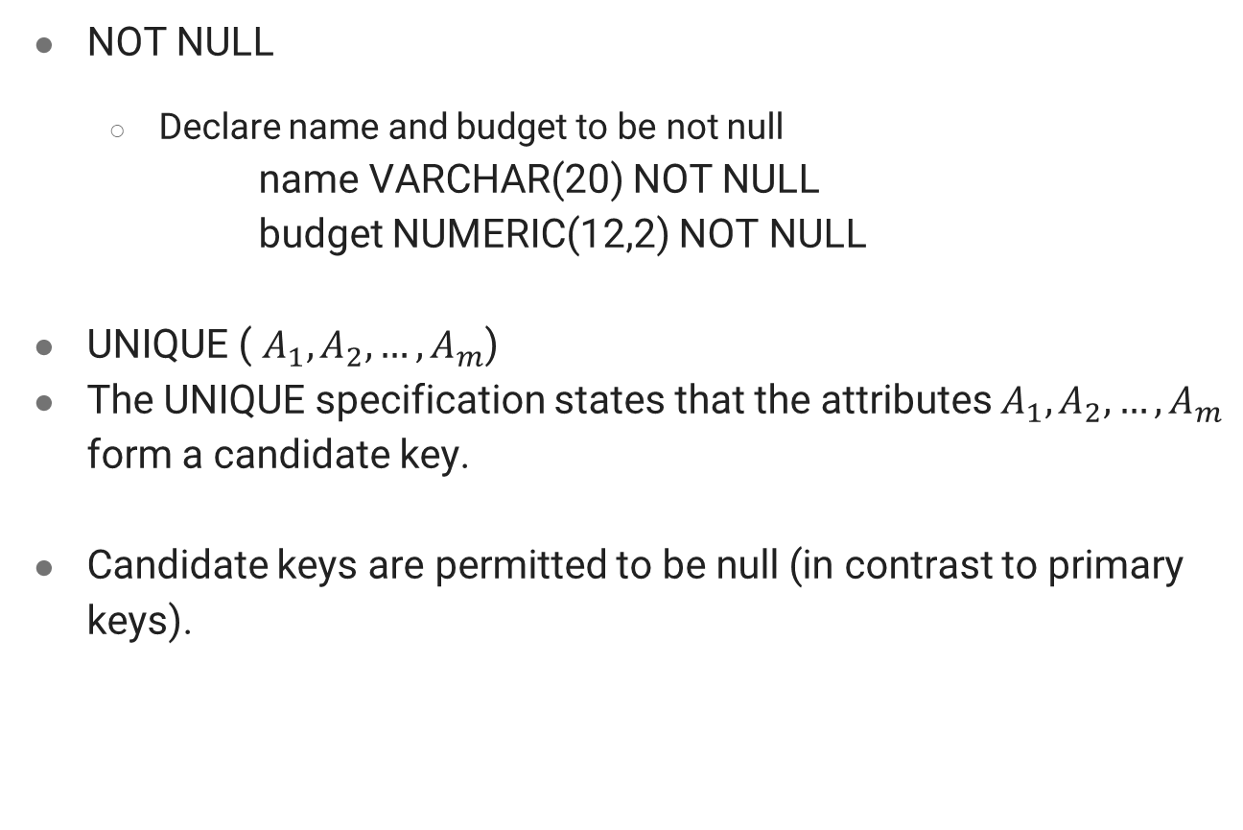
NOT NULL And UNIQUE
NOT NULL
Declare name and budget to be not null
name VARCHAR(20) NOT NULL budget NUMERIC(12,2) NOT NULL
UNIQUE ( $A_{1}, A_{2}, …, A_{m}$)
The UNIQUE specification states that the attributes $A_{1}, A_{2}, …, A_{m}$ form a candidate key.
Candidate keys are permitted to be null (in contrast to primary keys).

Slide 28
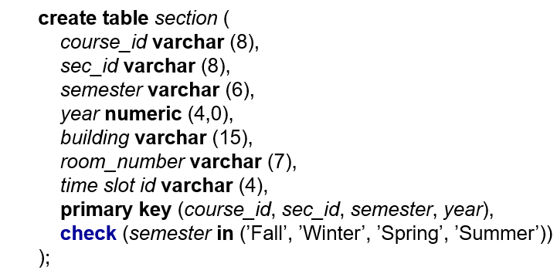
CHECK Clause
CHECK (P)
where P is a predicate
Example: ensure that semester is one of fall, winter, spring, or summer:

Slide 29
Referential Integrity
Ensures that a value that appears in one relation for a given set of attributes also appears for a certain set of attributes in another relation.
Example: If “Biology” is a department name appearing in one of the tuples in the instructor relation, then there exists a tuple in the department relation for “Biology”.

Slide 30
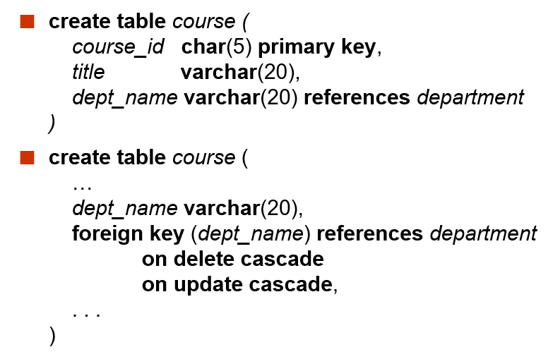
Referential Integrity - Example
Alternative actions: SET NULL, SET DEFAULT
Notes:
Complex scenarios should be handled by stored procedures and triggers -> after reading week

Slide 31
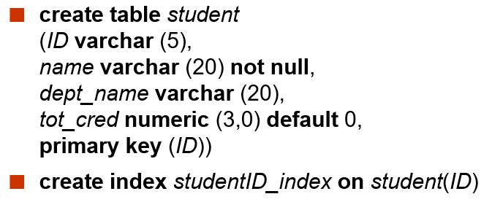
INDEX
Indices are data structures used to speed up access to records with specified values for index attributes
More on Silberschatz book Chapter 11

Slide 32
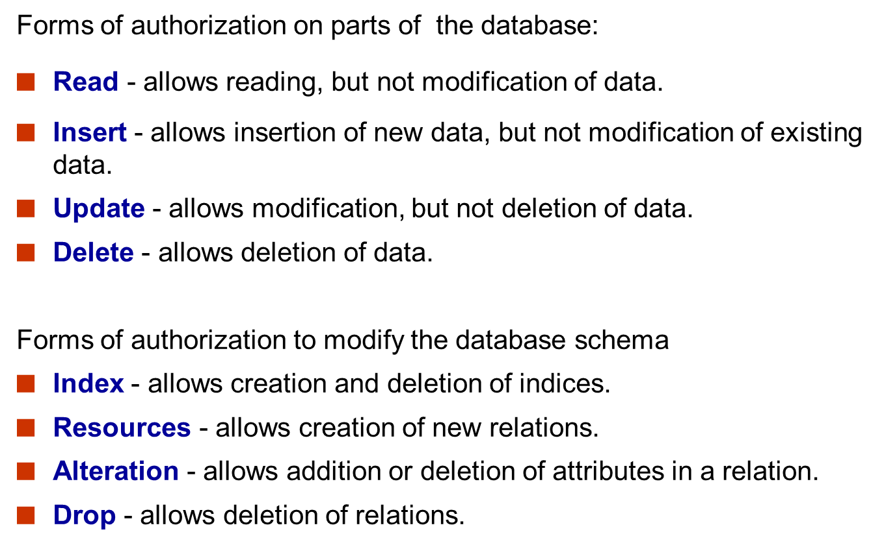
Authorization

Slide 33
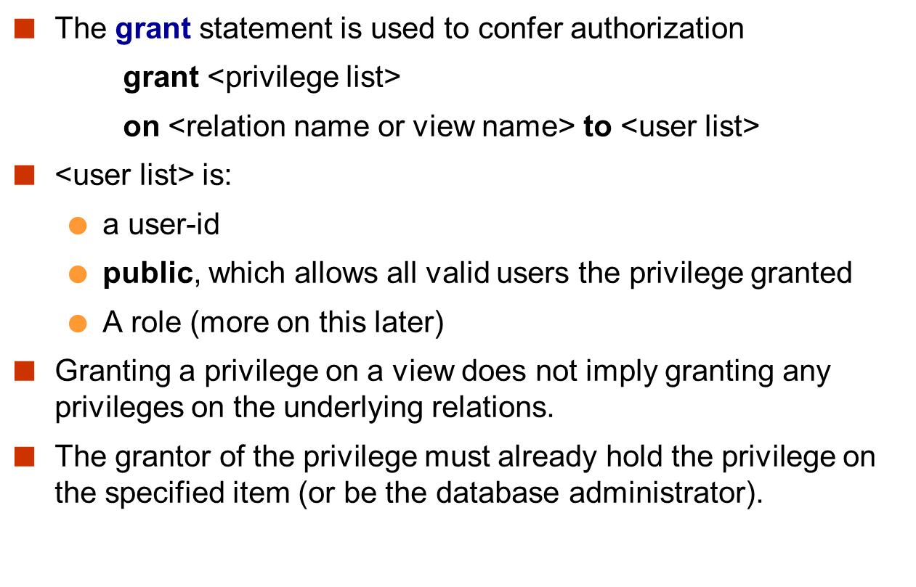
Authorization

Slide 34
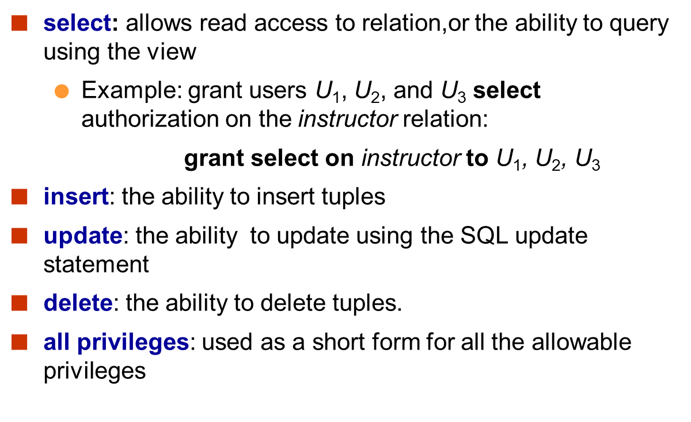
Privileges in SQL

Slide 35
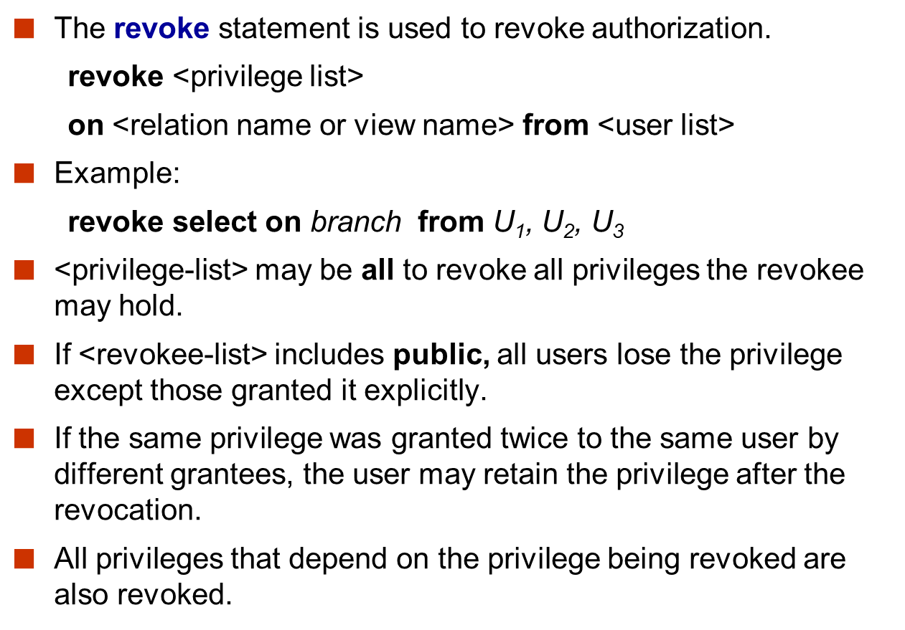
Revoking Authorization in SQL

Slide 36
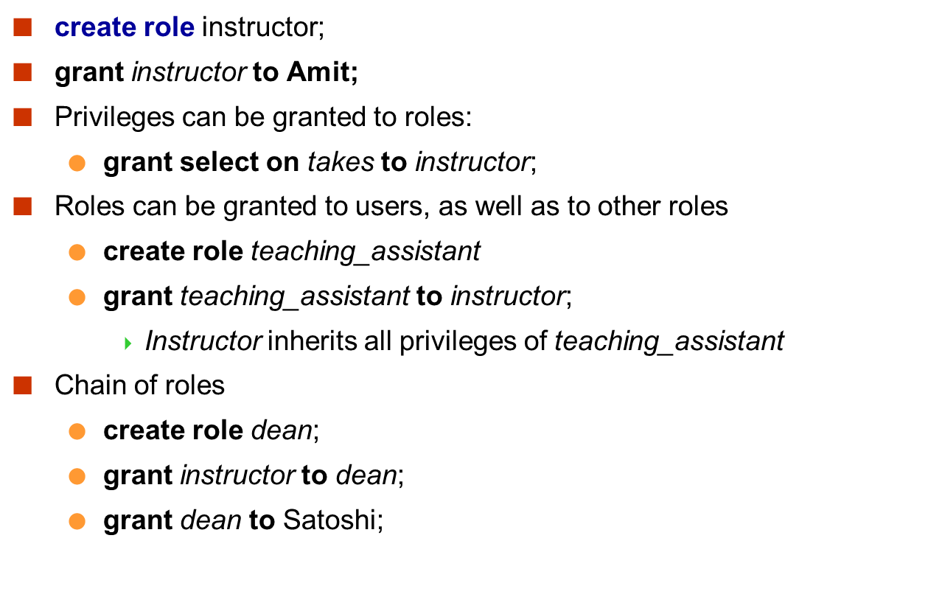
Roles

Slide 37
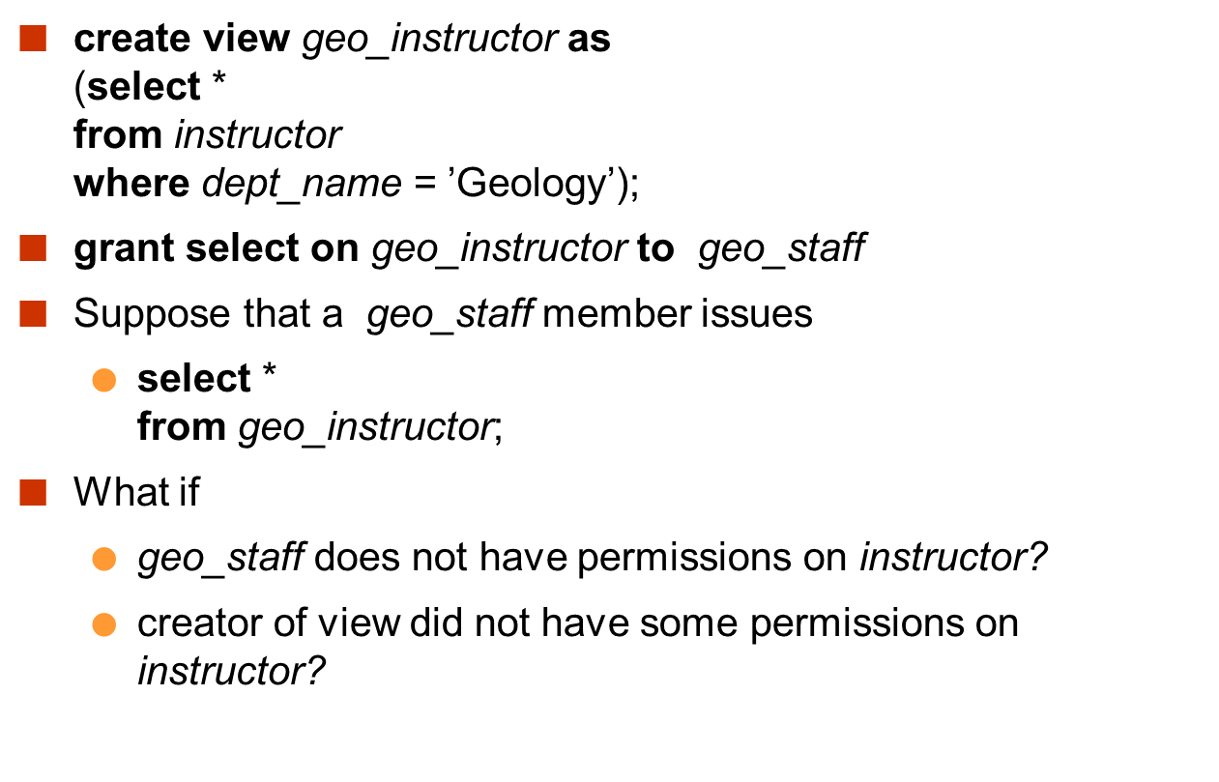
Authorization on Views

Slide 38
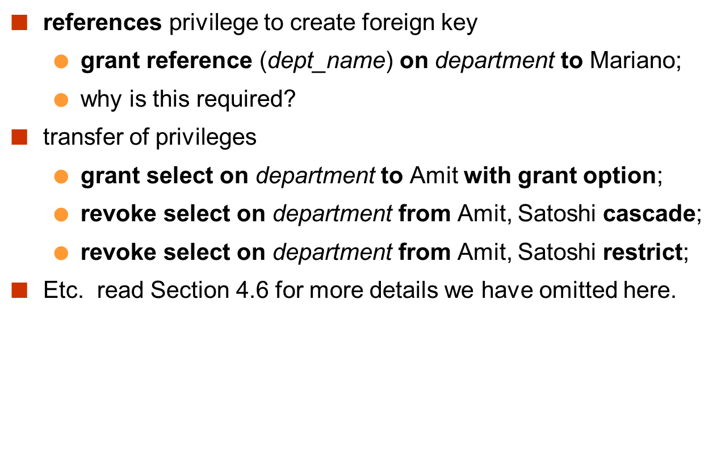
Authorization on Views

Slide 39
References
Database System Concepts - 6th edition (db-book.com)

